Slide 1

MYERS–BRIGGS TYPE INDICATOR (MBTI) CLASSIFICATION USING TEXT DATA
CS 584 – Theory/Application Data Mining
Dr Huzefa Rangwala
George Mason University
Date: 2nd December 2021
By: Janit Bidhan, Sashank Kakaraparty
Notes:
Start: Shashank : Class name and my name
Janit: Name and Title

Slide 2
Agenda
Problem in hand?
What is your Personality Type?
Motivation
Literature search
Data Pipeline | Experimental Evaluation | Results | Demo
Conclusions
Notes:
Janit: Agenda

Slide 3


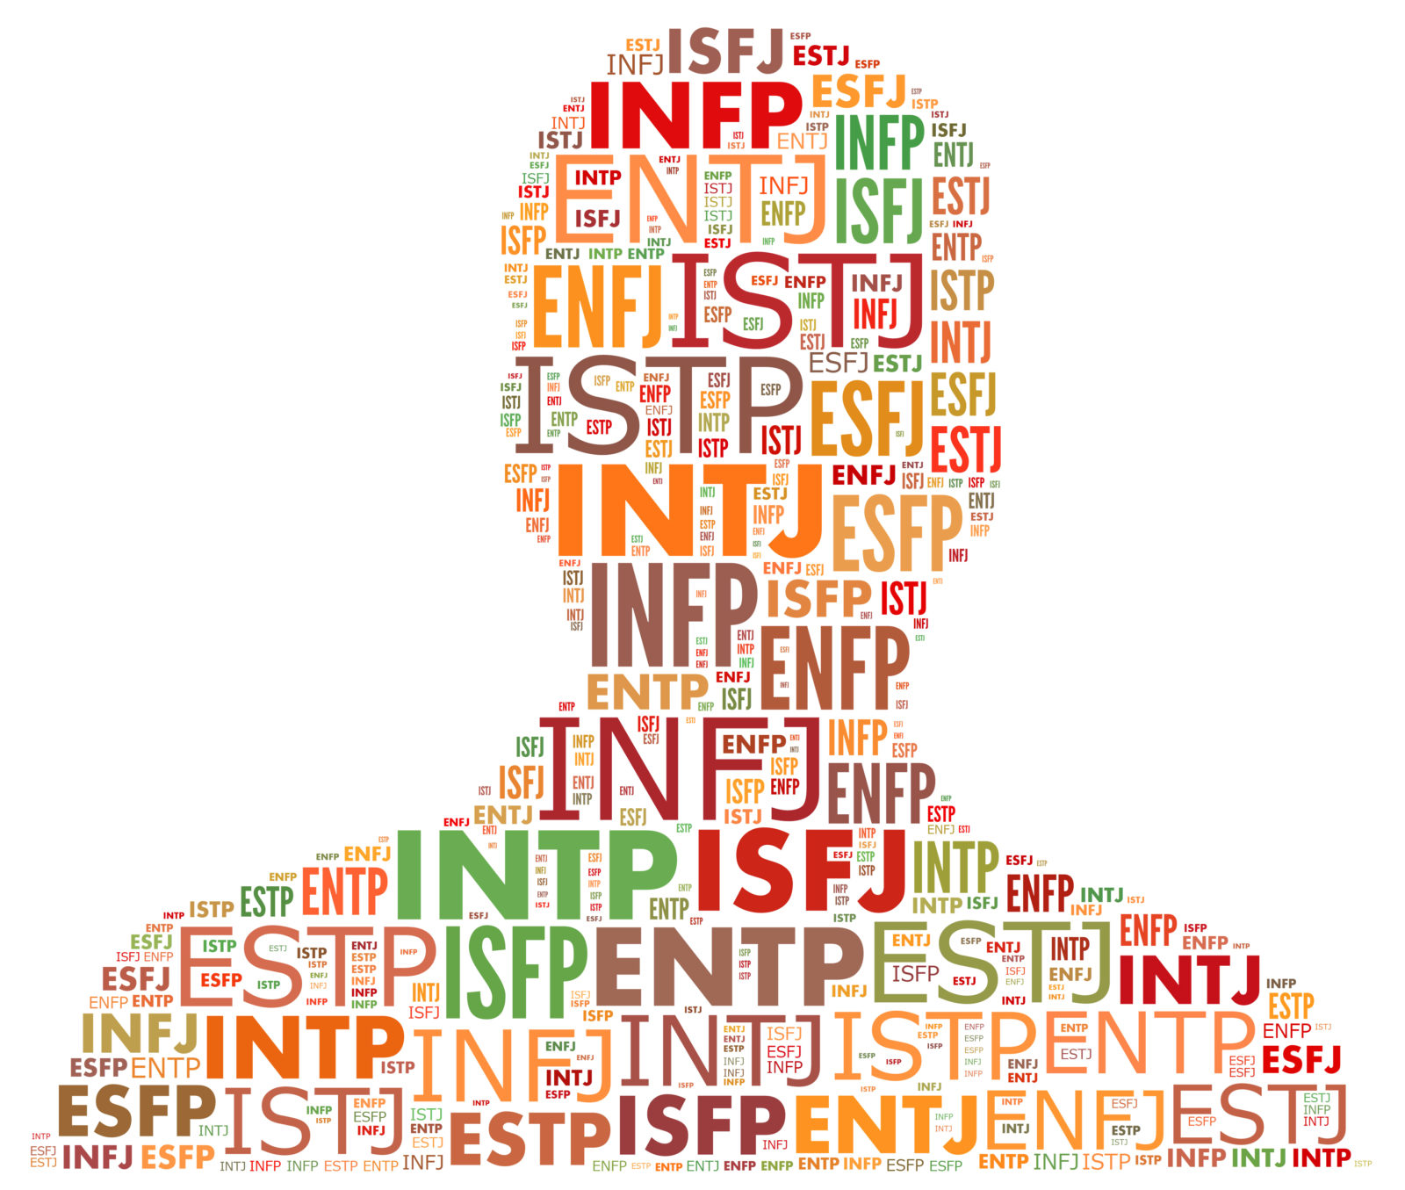
Problem in hand?
If a person is aware of his or her personality features, he or she can greatly boost productivity.
This applies to people of all ages, from students to working professionals.
A typical MBTI personality assessment is administered in the form of a questionnaire with more than 100 questions, which is time taking.
This process can be used to analyze the social media accounts to indicate the user’s personality as per the MBTI scale., which would be faster than the questionnaire
This Photo by Unknown Author is licensed under CC BY-SA-NC
Notes:
S: Problem in hand

Slide 4

Objectives
We want to provide a fast and effective way for analyzing the personality type using the text data extracted from social media platforms which could be either internal or external like Twitter, Facebook, Vimeo (internal social media used by many companies), etc.
Notes:
S: Problem what we are doing slides

Slide 5
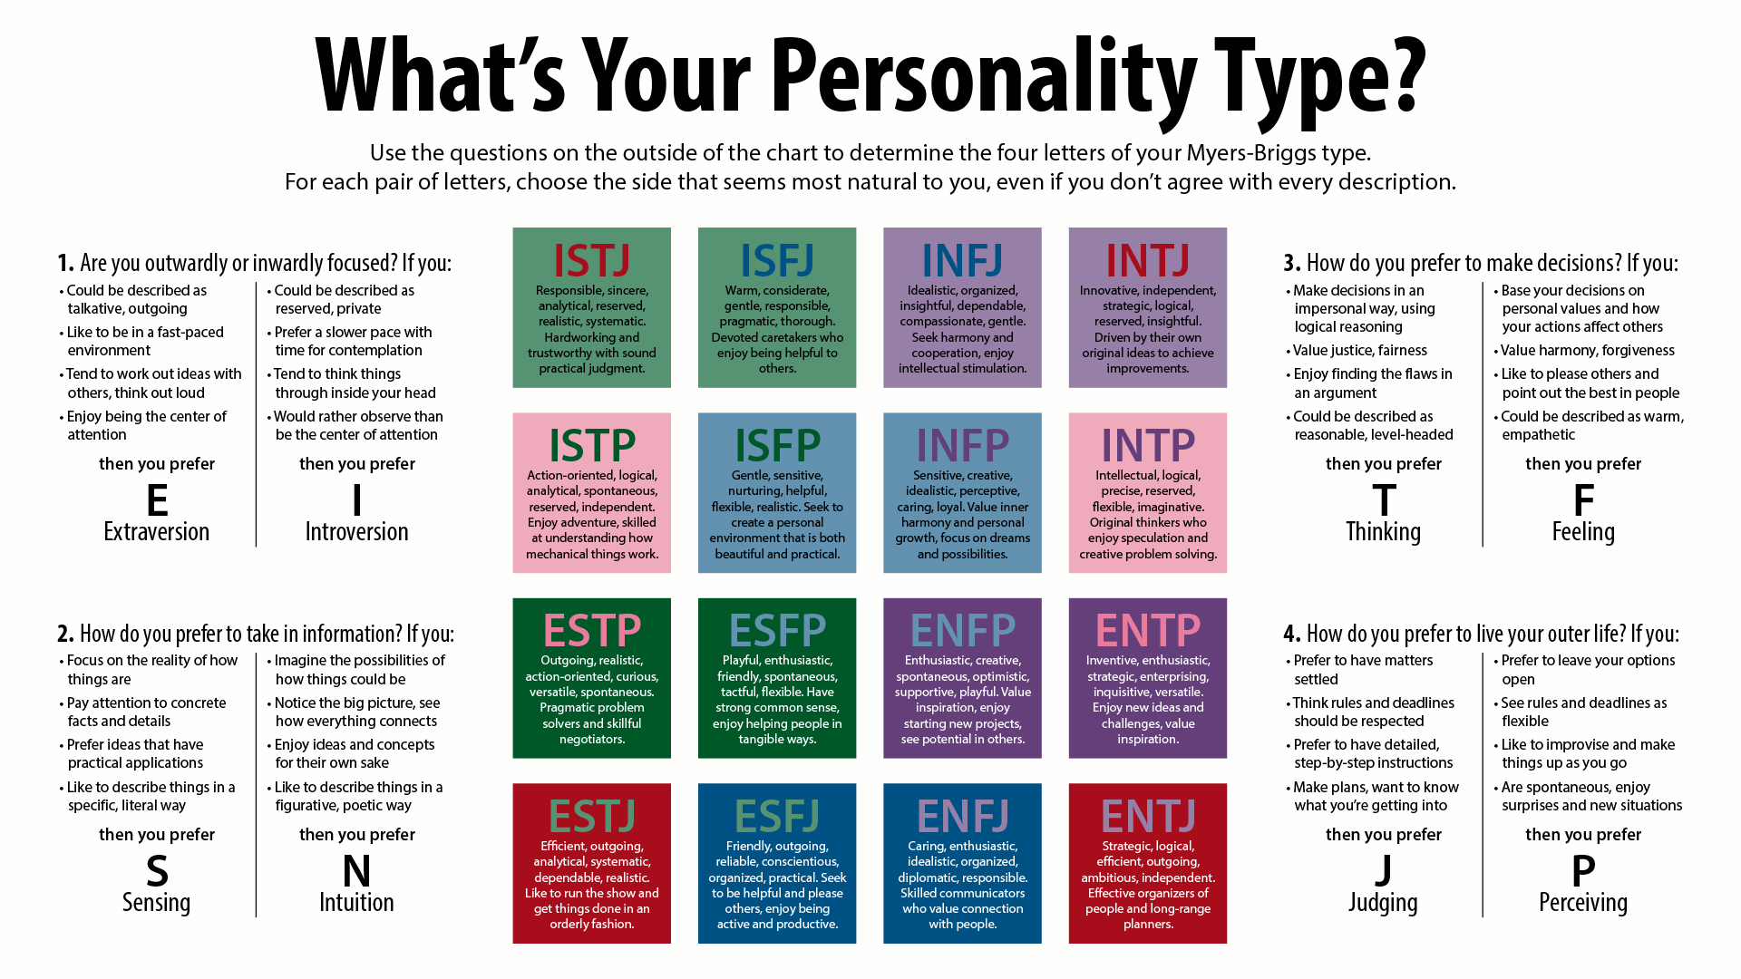
This Photo by Unknown Author is licensed under CC BY-SA
Notes:
J: Explain

Slide 6
Motivation
Increase self-awareness
Discover how people differ in terms of energy sources, information gathering, decision-making, and lifestyle.
Develop a respect for each person's unique talents and abilities.
Learn how to improve your team's performance by using your own and others' skills.
Compile a list of areas or possibilities for personal or professional growth.
Notes:
S: Motivation slides

Slide 7
Why this project makes sense?
Meta programmers, which are habitual ways of inputting, sorting and filtering the information found in the world around us, are a vital factor in Neuro Linguistic Programming (NLP) .
The Myers–Briggs Type Indicator (MBTI) is currently considered as one of the most popular and reliable methods.
In this project, a new machine learning method has been developed for personality type prediction based on the MBTI and in comparison, to other existing methods and the results show better accuracy and reliability.
There is significant growing interest in automated personality prediction using social media among researchers in both the Natural Language Processing and Social Science fields.
Notes:
S: Motivation slides

Slide 8

Literature search

Slide 9
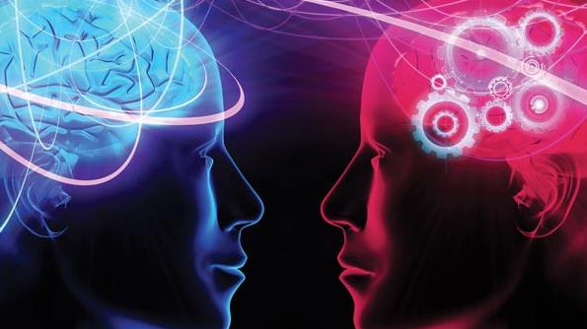
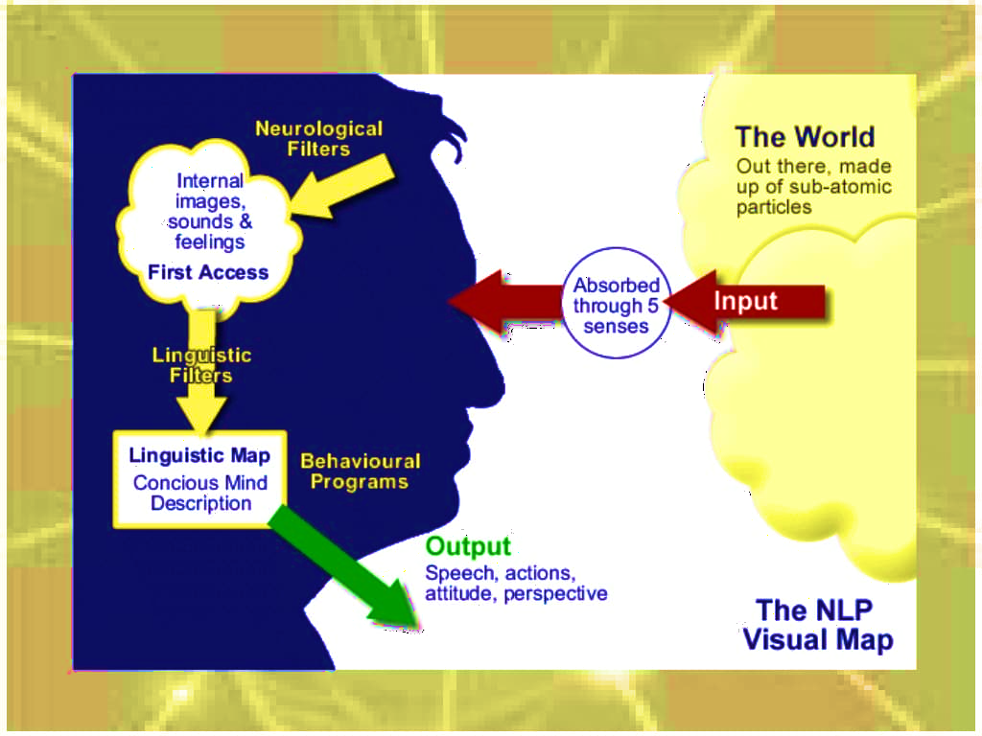
History of Neuro Linguistic Programming (NLP) → MBTI
The MBTI is the world’s most widely used and popular personality tool. It is based on Carl Jung’s psychological type theory (“type” meant typical).
Kathryn Briggs and daughter Isabel Briggs Myers extended and expanded Jung’s descriptions. They developed a structure of 16 types based on four opposites.
Neuro Linguistic Programming (NLP) is a collection of techniques that can help to identify how people think, how they communicate and how they behave.
Meta programmes can have a major influence on behaviors as well as how people communicate with others.
The initial list of NLP meta programmes included 60 different patterns. Many of these meta programmes have been combined by subsequent researchers to form a much smaller and more useful set.
Dr Wyatt Woodsmall developed meta programmes for use in business and therapy and integrated them with the Myers–Briggs Personality Inventory. He reduced the number of patterns again and made a smaller set of meta programmes, which includes only four basic and key meta programmes. These four basic meta programmes, also known as the Myers–Briggs Type Indicator (MBTI), describe the preferences of an individual in four dimensions and these basic dimensions combine into one of 16 different personality types.
These four dimensions or basic meta programmes are Extroversion–Introversion (E–I), Sensation–Intuition (S–N), Thinking–Feeling (T–F), and Judgment–Perception (J–P).
Notes:
J: Explain
The MBTI is the world’s most widely used and popular personality tool. It is based on Carl Jung’s psychological type theory. Many people think “type” means a particular kind of person, but Jung’s original use of the word “type” meant typical.
Kathryn Briggs and daughter Isabel Briggs Myers extended and expanded Jung’s descriptions. They developed a structure of 16 types based on four opposites.
People use different strategies for doing different things and making decisions.
Dr Wyatt Woodsmall further developed Meta Programs for use in business and therapy. His set of Meta Programs in his 1988 publication “Metaprograms” included:

Slide 10
Model and Methods
Study | Personality Model | Method
Champa and Anandakumar (2010) | MBTI Network | Artificial Neural
Golbeck and et al. (2011) | MBTI Algorithms | Regression
Komisin and Guinn (2012) | MBTI Bayes and SVM | Naïve
Wan and et al. (2014) | Big Five Naive Bayes | Logistic Regression
Li, Wan and Wang (2017) | Big Five Learning | Multiple Regression and Multi-Task
Tandera and et al. (2017) | Big Five Architecture | Deep Learning
Cui and Qi (2017) | MBTI Learning | Baseline, Naïve Bayes, SVM and Deep
Most studies on personality prediction have focused on the Big Five or MBTI personality models, which are the two most used personality models in the world.
Research done on personality type prediction and personality models used the classification techniques as mentioned in the table.
Notes:
J: Explain

Slide 11



Data Pipeline and Experimental Evaluation

Slide 12
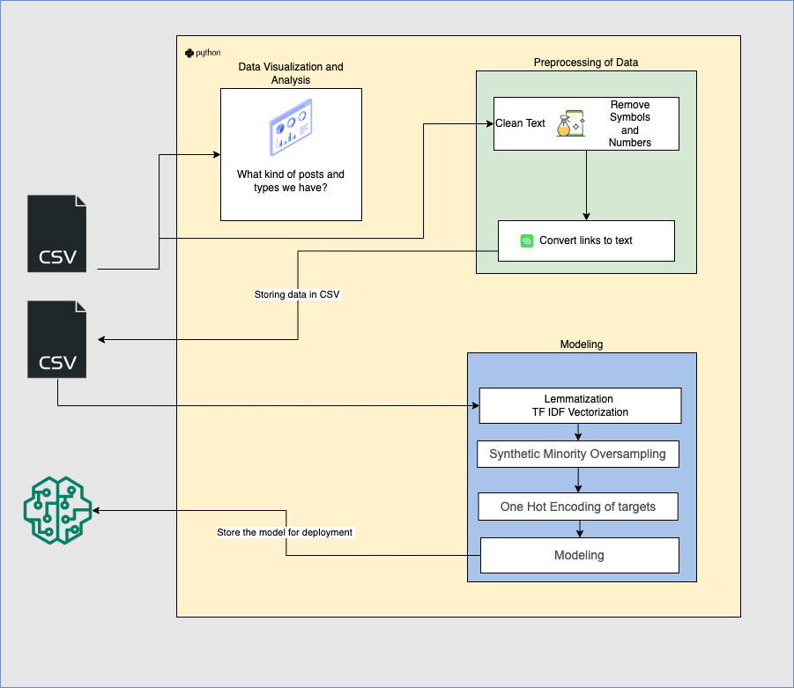
Project Execution
Notes:
S: Explain

Slide 13
Experimental Evaluation and Results
Models | Test Accuracy
CatBoost Classifier | 0.69276
Linear Support Vector Classifier | 0.68671
XGBoost Classifier | 0.68296
Neural Network Classifier | 0.64979
Support Vector Classifier | 0.64102
Logistic regression | 0.61342
Random Forest Classifier | 0.49878
Notes:
S: Explain

Slide 14
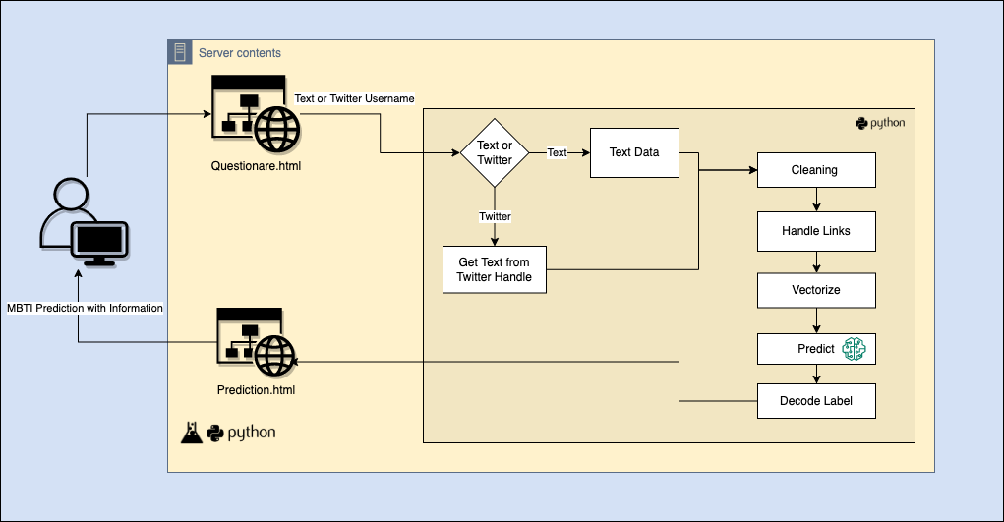
Live Demo
Notes:
J: Explain
Start: S :: Demo part 1: Questionare.html
J: Part 2 with feedback

Slide 15

Conclusions
Notes:
S: Start

Slide 16

Good vs Bad, Ethics?
Self-awareness is critical for efficient self-management. Recognize the patterns in your conduct that lead to favorable outcomes. Identify the tendencies in your behavior that lead to less desired consequences. Connect patterns to other data points to better understand personal or professional growth prospects.
Attempting to predict the behavior of others Trying to figure out what personality someone else is (ex. You must be an extravert because you are so gregarious.)
There could be some unethical uses of the MBTI, where we should not be using it for solely criterion for Hiring, Selecting, Promoting and Rewarding. Assuming that how a preference manifests for you is the same way it manifests for someone else. Justification of behavior (for example, declaring that someone "must be a P" since he is constantly late.)
Notes:
S: Good
J: Bad
Act like a discussion

Slide 17


Challenges Future Opportunities and use cases
There is a scarcity of labeled data.
It's probable that we won't obtain an accurate picture of a user's personality from their social media.
Automated personality prediction from social media may be used in a variety of settings, including social media marketing and dating apps and websites.
The person can have a better understanding of his personality by analyzing both the text and the quiz.
The results of this study can assist NLP practitioners and psychologists regarding identification of personality types and associated cognitive processes.
It could aid organizations/schools in determining which aspects of the individual require support and training.
The use of recurrent Neural Networks may improve prediction accuracy.
Notes:
S: Challenges
J: Future

Slide 18

Thank You

